Slide 1
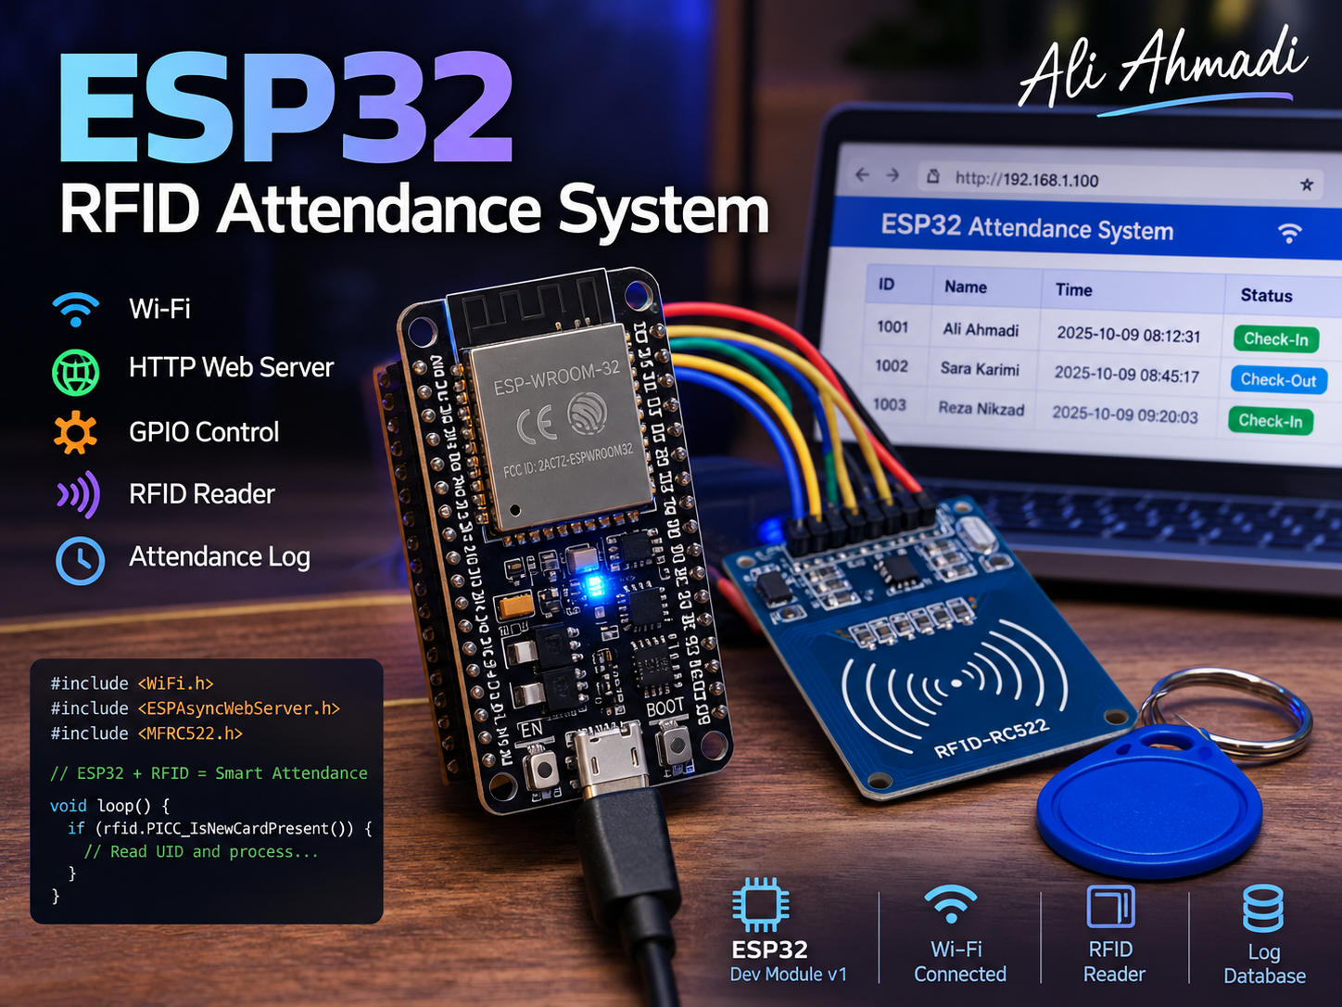
ESP32 RFID Attendance & Access Control System
Design and implementation of an embedded system for user identification, access control, attendance tracking, and over-the-air (OTA) updates.

Slide 2
Project Idea and Objectives
User identification using RFID
Time-based access control for each user
Employee check-in and check-out tracking
Local and server-side data storage
System status display on an OLED
Wi-Fi-based firmware updates (OTA)
RFID
ESP32
Attendance / Relay / Server

Slide 3
System Architecture
RFID CARD
MFRC522
ESP32
OLED
Relay
WIFI
Display
Access
PHP Server
CSV File
SPI

Slide 4
Hardwares
ESP32
DS1307 RTC
microSD Module
5V Relay Module
Logic Level Shifter
Buzzer
MFRC522
SSD1306 OLED 0.96"

Slide 5
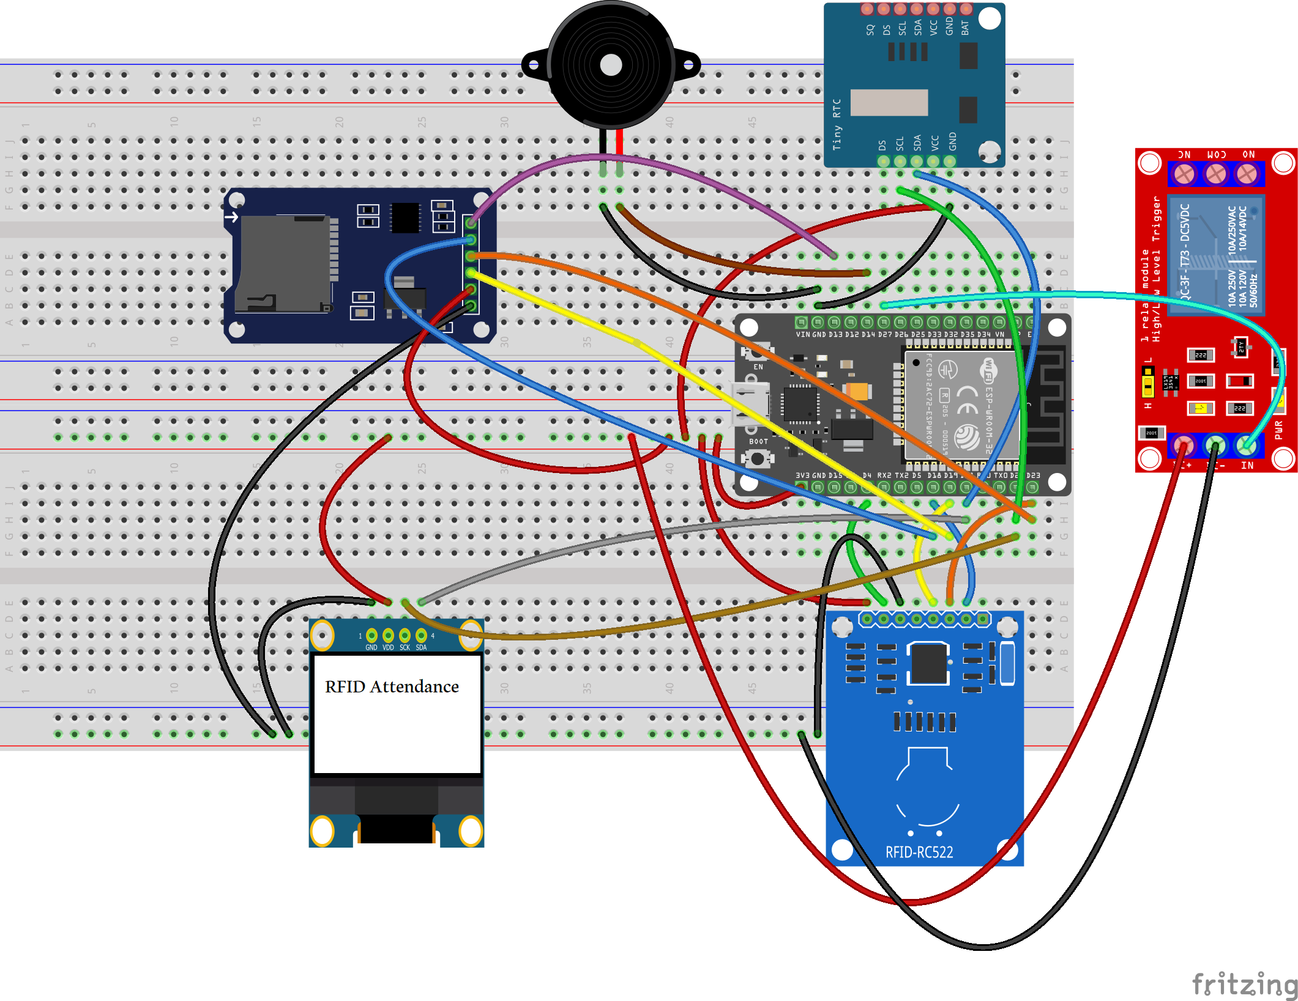
Connections and Pin Mapping
Module | Protocols | ESP32
MFRC522 | SPI | SCK=18, MISO=19, MOSI=23
MFRC522 CS | Digital | GPIO 5
MFRC522 RST | Digital | GPIO 4
microSD CS | Digital | GPIO 13
DS1307 | I²C | SDA=21, SCL=22
OLED | I²C | SDA=21, SCL=22
Relay | Digital | GPIO 27
Buzzer | Digital | GPIO 14

Slide 6
Start
Scan RFID
Read UID
Identify User
Allowed Time Verification
Is It Allowed?
Yes
No
IN/OUT
Access Denied
Data Logging
Show Results
System Operation
Note: After displaying the result, the system returns to the next card-scanning stage.

Slide 7
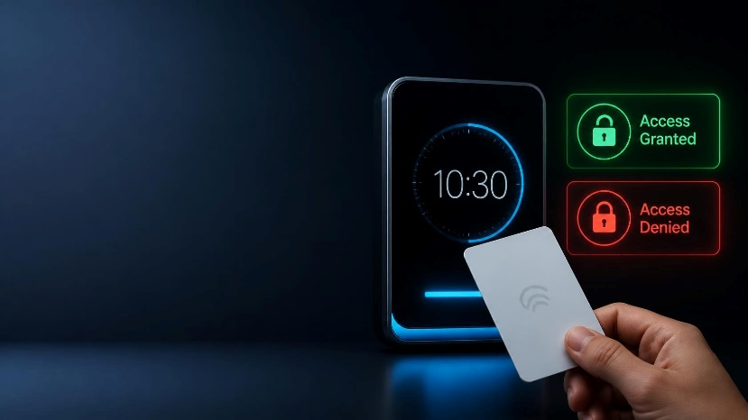
Time-Based Access Control
Each RFID card has its own designated access time window.
Example:
User | IN | OUT
Ali Ahmadi | 07:30 | 18:30
Vahid Kordloo | 08:00 | 15:00
Fatemeh Asadi | 09:00 | 17:00
• Note: If a card is scanned outside its authorized time window, access is denied, and no attendance record is created.

Slide 8
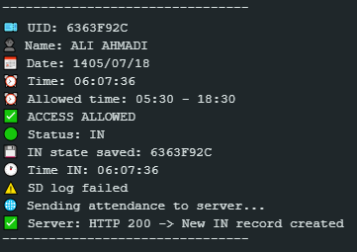
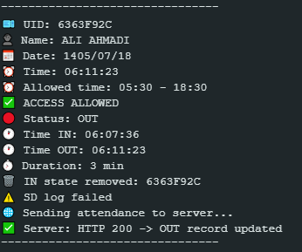
Check-In / Check-Out Logging
08:12:31
CARD SCAN
CHECK-IN
Relay ON
08:45:17
CARD SCAN
CHECK-OUT
Duration = 32 min
# User check-in status is stored in the ESP32’s internal memory, allowing active check-in states to be recovered after a reset or power outage.
IN
OUT

Slide 9
Data Storage
ESP32
Wi-Fi
MicroSD
Attendance.csv
Attendance.php
Attendance.csv

Slide 10
A Real-World Hardware Challenge: SPI Bus Conflict
Initially, an SD card module featuring an AMS1117 voltage regulator and a 74HC125 logic buffer was used. After connecting this module, communication with the MFRC522 RFID reader became unstable, resulting in invalid values such as 0xFF.
Disconnecting the SD module’s MISO line revealed that the issue was caused by interference on the SPI bus.
To resolve the issue, a 3.3V logic-level microSD module was used, and separate CS (Chip Select) pins for the RFID and SD modules were managed in the firmware.

Slide 11
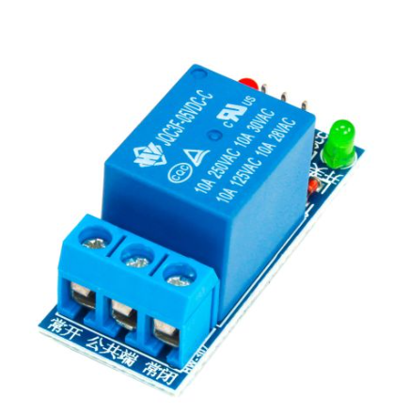
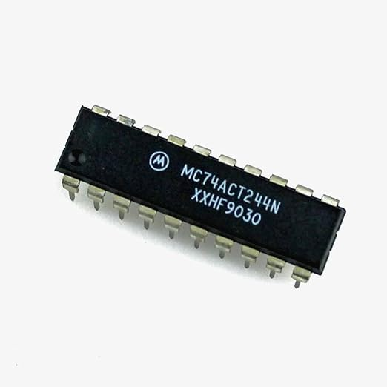
ESP32 Interface with a 5V Relay
ESP32 3.3V GPIO
Logic Level Shifter
5V Logic
5V Relay
Load / Door Lock

Slide 12
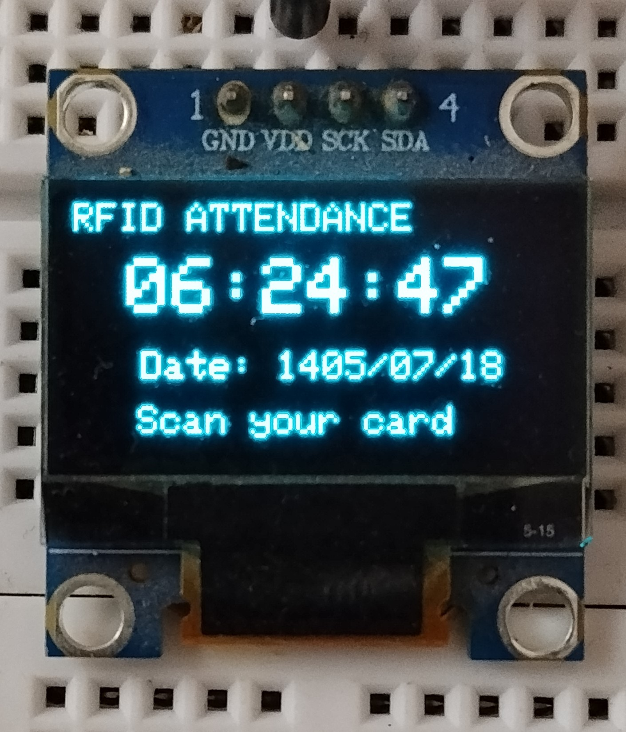
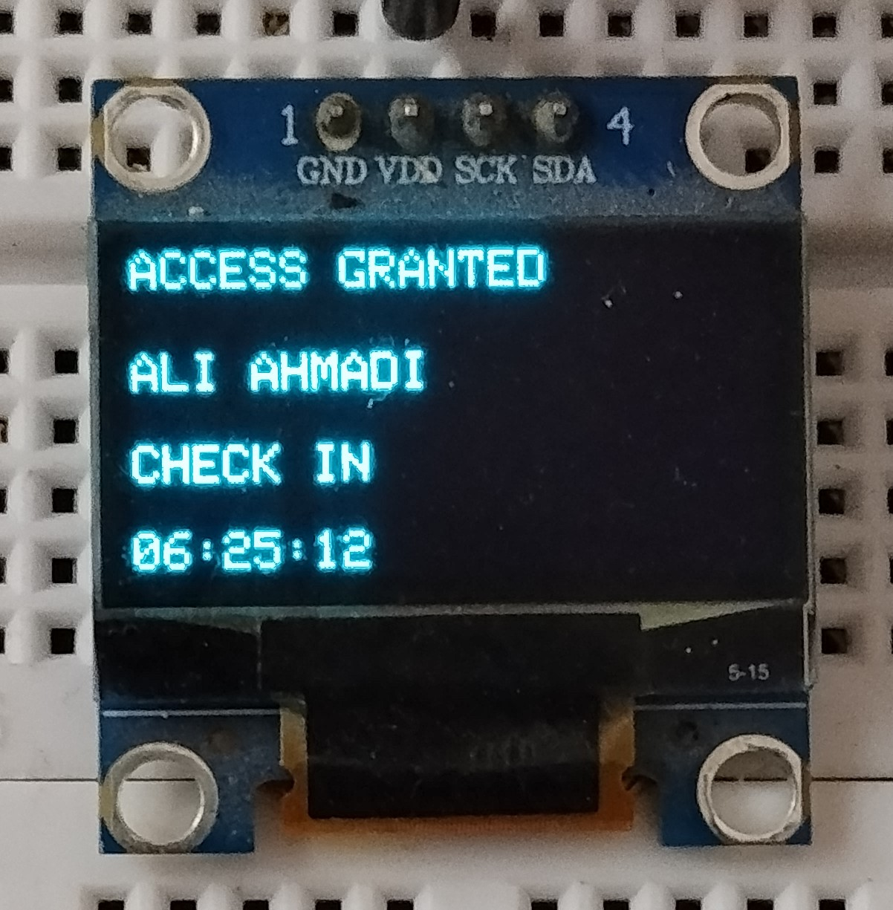
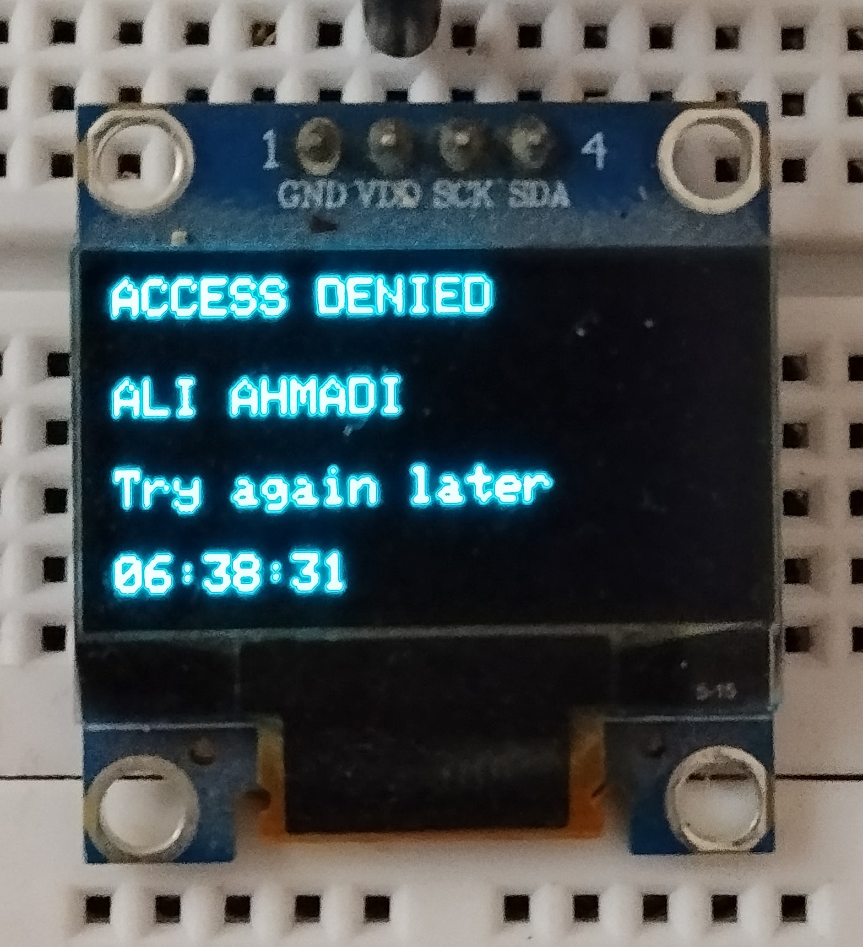
OLED Interface

Slide 13
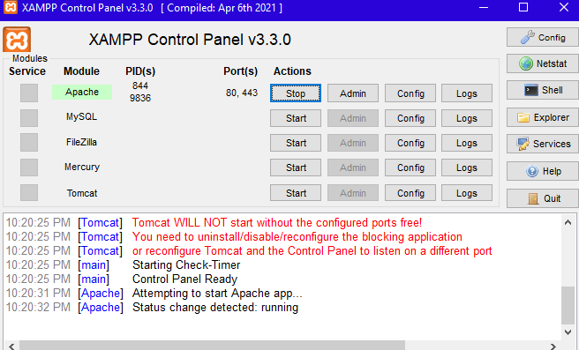
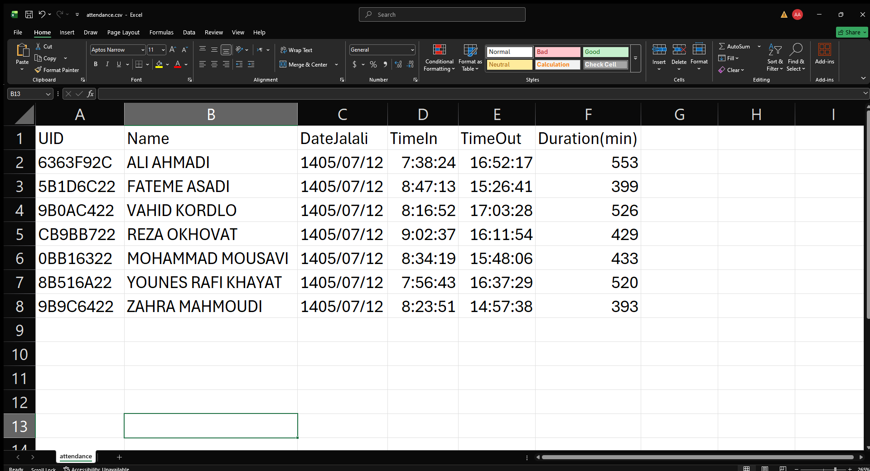
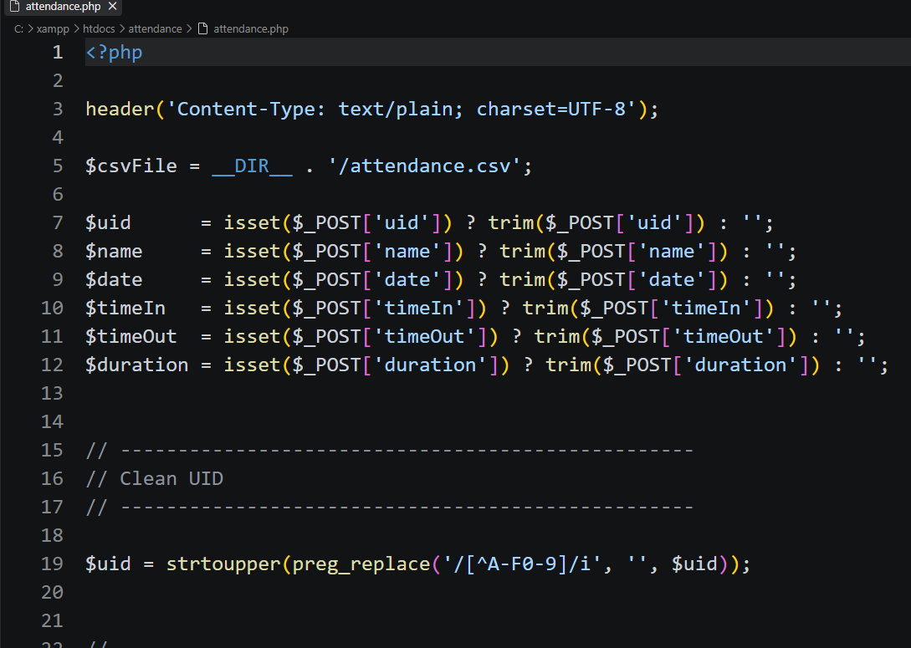
Connecting to Server
ESP32
HTTP POST
Apache/ PHP
Attendance.csv

Slide 14
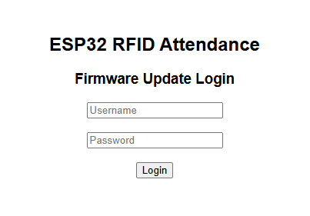
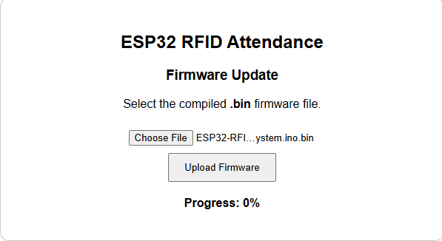
Browser-Based Firmware Update
Arduino IDE
Compile
.bin
Browser
Upload Firmware
100%
ESP32 Restart

Slide 15
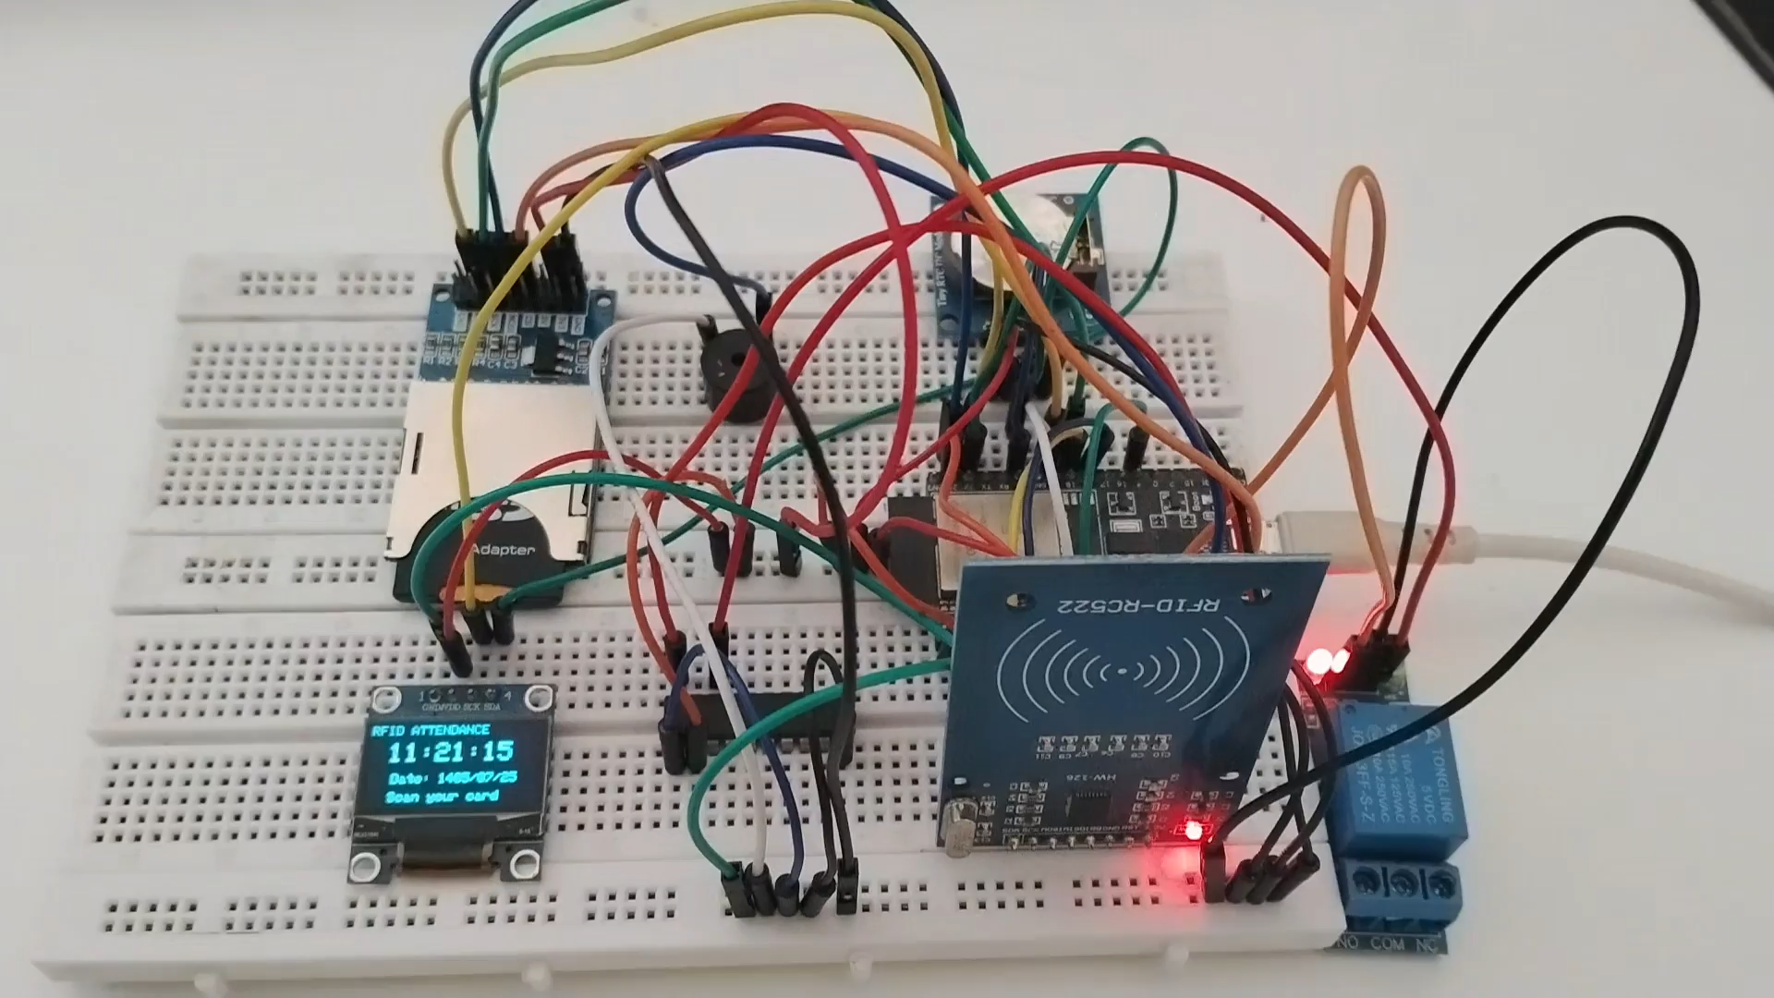
Result: A complete embedded system for identification, access control, and attendance tracking, featuring local data storage, server communication, and Wi-Fi-based firmware updates.

